Slide 1

Spring of Code Artificial Intelligence (Machine Learning & Deep Learning)
Instructor Asad Ullah - Research Assistant (DIP Lab)
Duration 03 Months (Feb – April)

Slide 2

Day 03 – Implementation of OOP (Classes and Objects)
Objectives:
Classes and Objects
Instance Variables and Methods
Class Variables
Inheritance
Special Methods

Slide 3
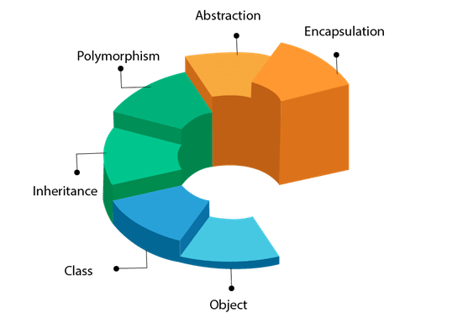
Object Oriented Programming (OOP)

Slide 4
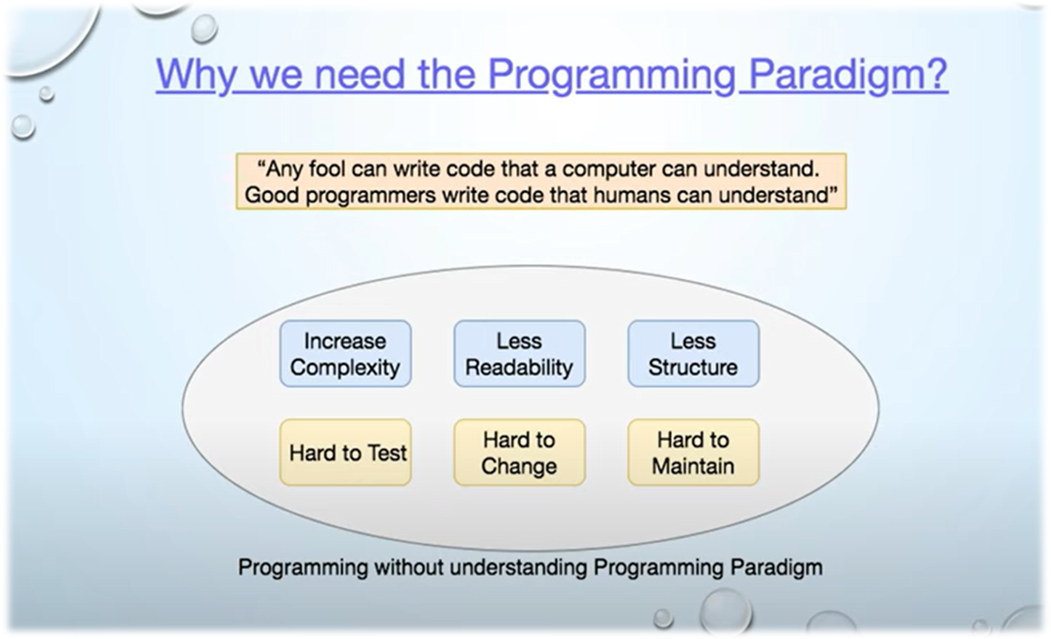

Slide 5
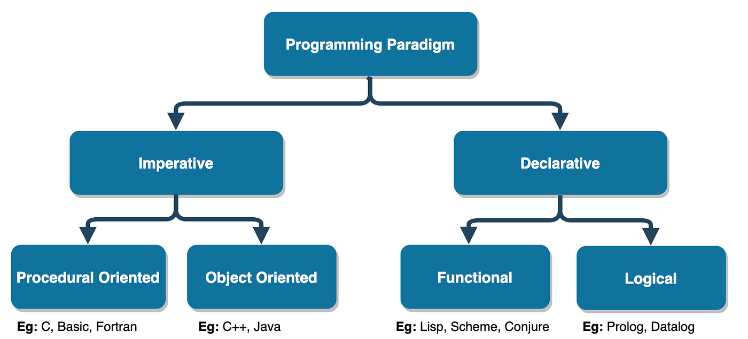
Different Programming Paradigms
Notes:
"HOW to do it" - Step-by-step instructions
"WHAT to do" - Describe desired result

Slide 6
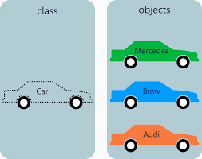
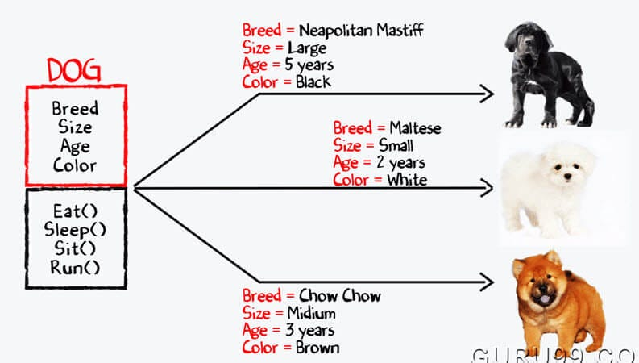
Classes & Objects
Classes are blueprints or templates for creating objects. Think of them as a real-world entity.
Objects are instances of classes, representing a specific example of the class.
Objects can store data (attributes) and have behavior (methods).
Example:
class Dog:
pass
my_dog = Dog()
Key Concept:
Each object shares the class structure but holds unique data.
Classes improve modularity and reusability.
Reusability: Once a class is defined, you can create multiple objects from it.
Modularity: Encapsulation of data and methods within a class.
Notes:
Class: A blueprint in code that defines attributes (data) and methods (behaviors) for objects.
Object: A specific instance of the class, created using the blueprint.

Slide 7
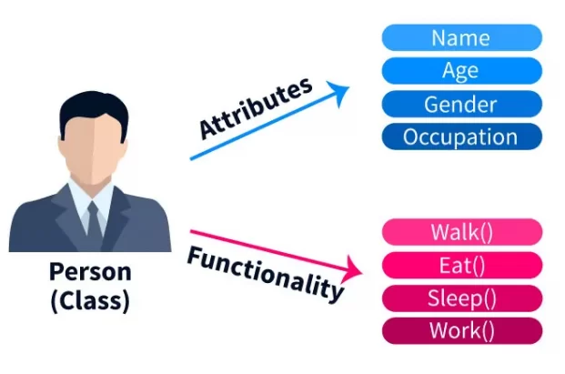
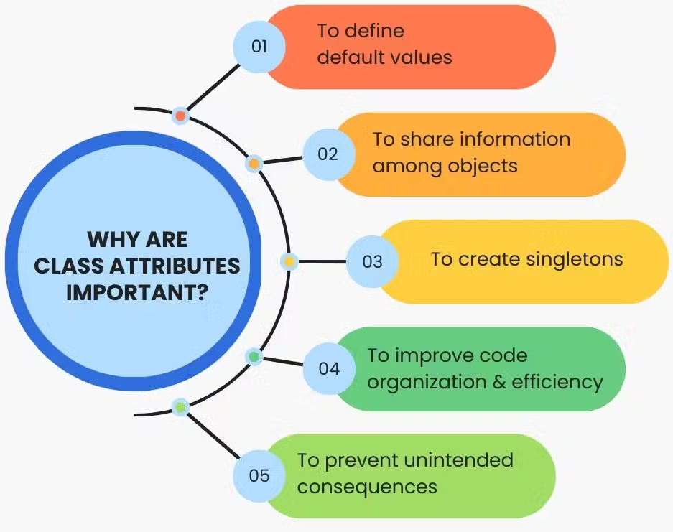
Attributes and Methods
Attributes (Properties):
Variables that store the state of an object.
Methods:
Functions defined inside a class that describe the behaviors of the object.
Example:
class Dog:
def __init__(self, name, breed):
self.name = name # Attribute
self.breed = breed # Attribute
def bark(self): # Method
print(f“{self.name} is barking!”)
Methods’ Role: Operate on the instance’s data and can change the object’s state.
Attributes’ Role: Represent the object’s characteristics (e.g., name, breed, age).
Notes:
- A variable is called an attribute inside a class in object-oriented programming because it represents a feature of the class or object
Attributes can be defined:
Inside the class but outside any methods (class attributes).
- Inside instance methods, especially the constructor (instance attributes).
functions defined inside a class are referred to as methods.
method is associated with an object, while a function is independent

Slide 8
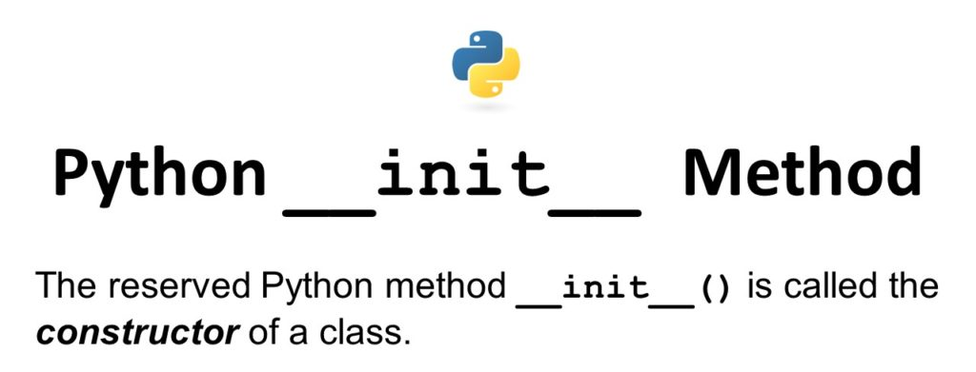
The __init__ Method (Constructor)
Special method automatically called when a new object of the class is created.
Purpose:
Used to initialize the object’s attributes.
The __init__ method sets the initial values for attributes like name and age upon object creation.
Example:
class Dog:
def __init__ (self, name, age):
self.name = name
self.age = age
self keyword:
Refers to the instance of the class and allows access to its attributes and methods.
Notes:
self refers to the current instance of the class.
- It is used to access instance attributes and methods within the class.
- It is not a reserved keyword; you can use any name, but by convention, self is used.
- When you call dog1.greet(), Python automatically passes the dog1 object as the first argument (self), so that the method can access the instance's attributes and behavior.
No, a class is not required to have a constructor (__init__). If no constructor is defined, Python provides a default one that does nothing.
constructor in Python must be named __init__. It is a special method recognized by Python and is automatically called when an object is created.

Slide 9
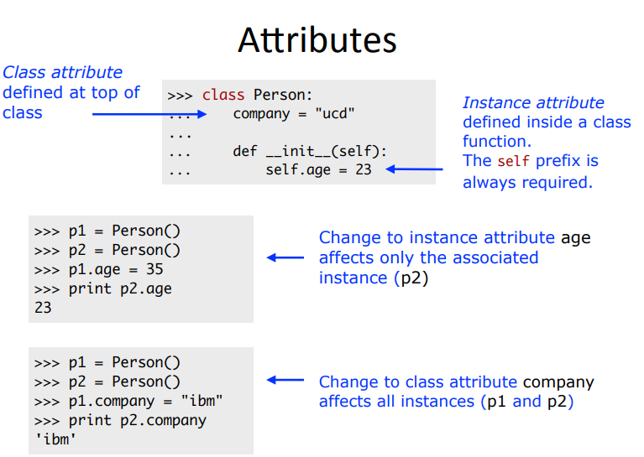
Class vs Instance Attributes
Instance Attributes:
Specific to a particular instance/object, defined within __init__
Class Attributes:
Shared across all instances, defined directly within the class.
Example:
class Dog:
species = ‘Canine’ # Class Attribute
def __init__ (self, name, age):
self.name = name # Instance Attribute
self.age = age
Class attributes are the same for all objects created from that class.
Instance attributes vary from object to object.
Notes:
Class attributes are variables defined at the class level, outside of any method.
They are shared among all instances of the class.
Visual Representation:
Dog 1: name = 'Rex', age = 2.
Dog 2: name = 'Buddy', age = 4.
Both have species = 'Canine' as a shared class attribute.
Instance attributes are variables that belong to a specific instance of the class.
These are typically defined in the constructor (__init__) or in other instance methods using self.

Slide 10
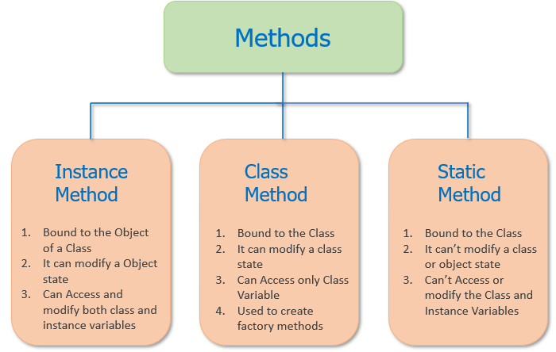
Types of Methods
Instance Methods: Operate on an instance of the class and access/modify instance attributes.
Class Methods: Operate on the class itself and have access to class attributes.
Static Methods: Standalone functions within a class. Don’t operate on instances or the class itself.
Notes:
When we talk about instance of the class, the most commonly used is the instance method.
Instance method takes object as the first argument.
Use Cases:
Instance methods for object-specific behavior.
Class methods for operations related to the class as a whole (e.g., factory methods).
Static methods for utility/helper functions.

Slide 11
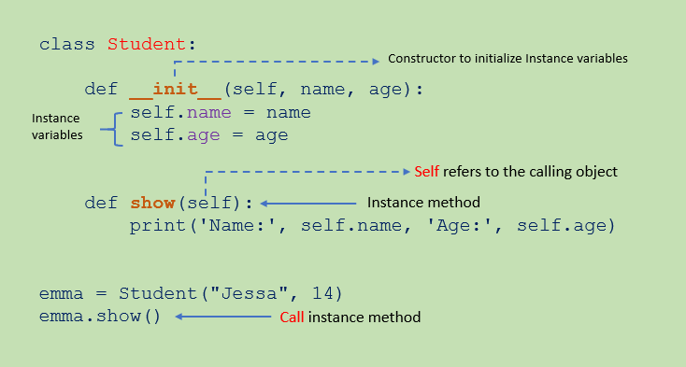
Instance Methods
Operate on individual objects of the class and typically modify instance attributes.
Requires self as the first parameter to refer to the specific instance.
Example:
class Dog:
def __init__ (self, name):
self.name = name
def bark(self):
print(f”{self.name} barks!”)
Explanation: self allows each instance to access its own data.
Key Points:
Used to manipulate or retrieve instance-specific data.
Can modify object state.

Slide 12
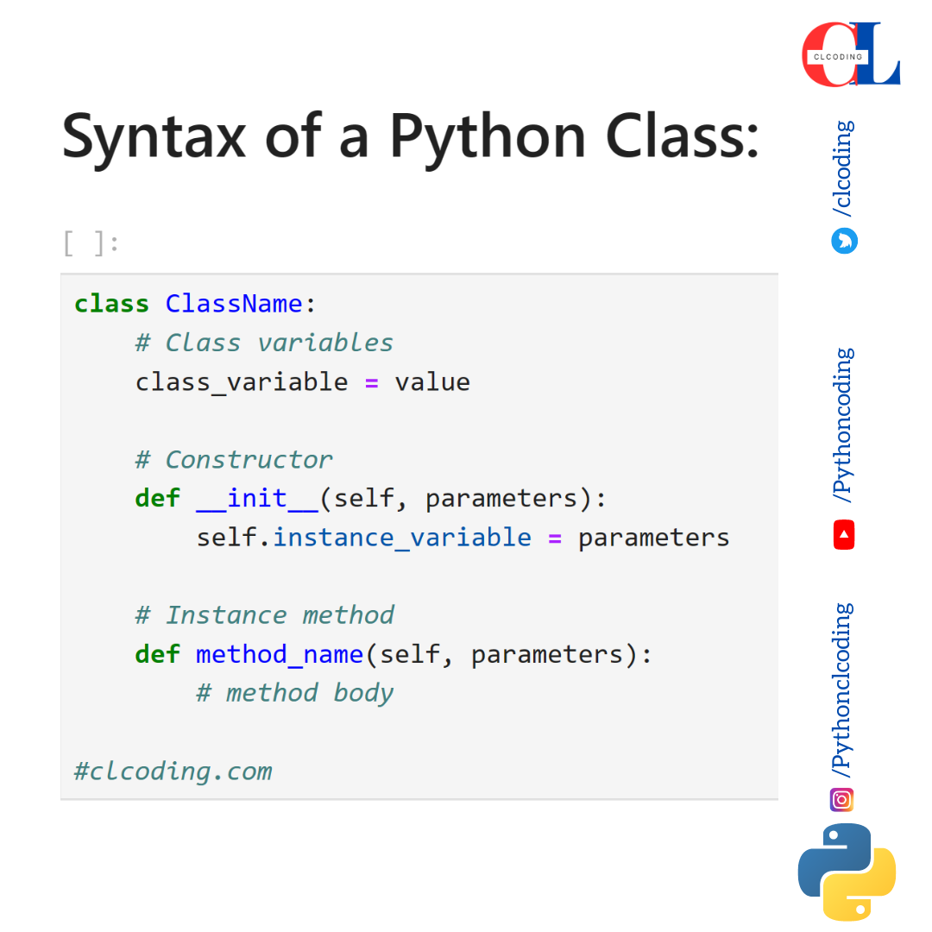
Class Methods
Methods that operate on the class itself and typically use @classmethod decorator.
Uses cls as the first parameter to refer to the class.
Example:
class Dog:
species = ‘Canine’
@classmethod
def show_species(cls):
print(f”All dogs are {cls.species}.”)
Explanation: Class methods are often used for operations that affect the class as a whole, like modifying class-level attributes.
Notes:
The @classmethod decorator indicates that the method it decorates is a class method, not an instance method.
cls stands for class, and it is the first parameter passed to the class method.
Yes, you can use any valid variable name instead of cls
A decorator is a function that modifies or enhances another function or method — without changing its actual code

Slide 13
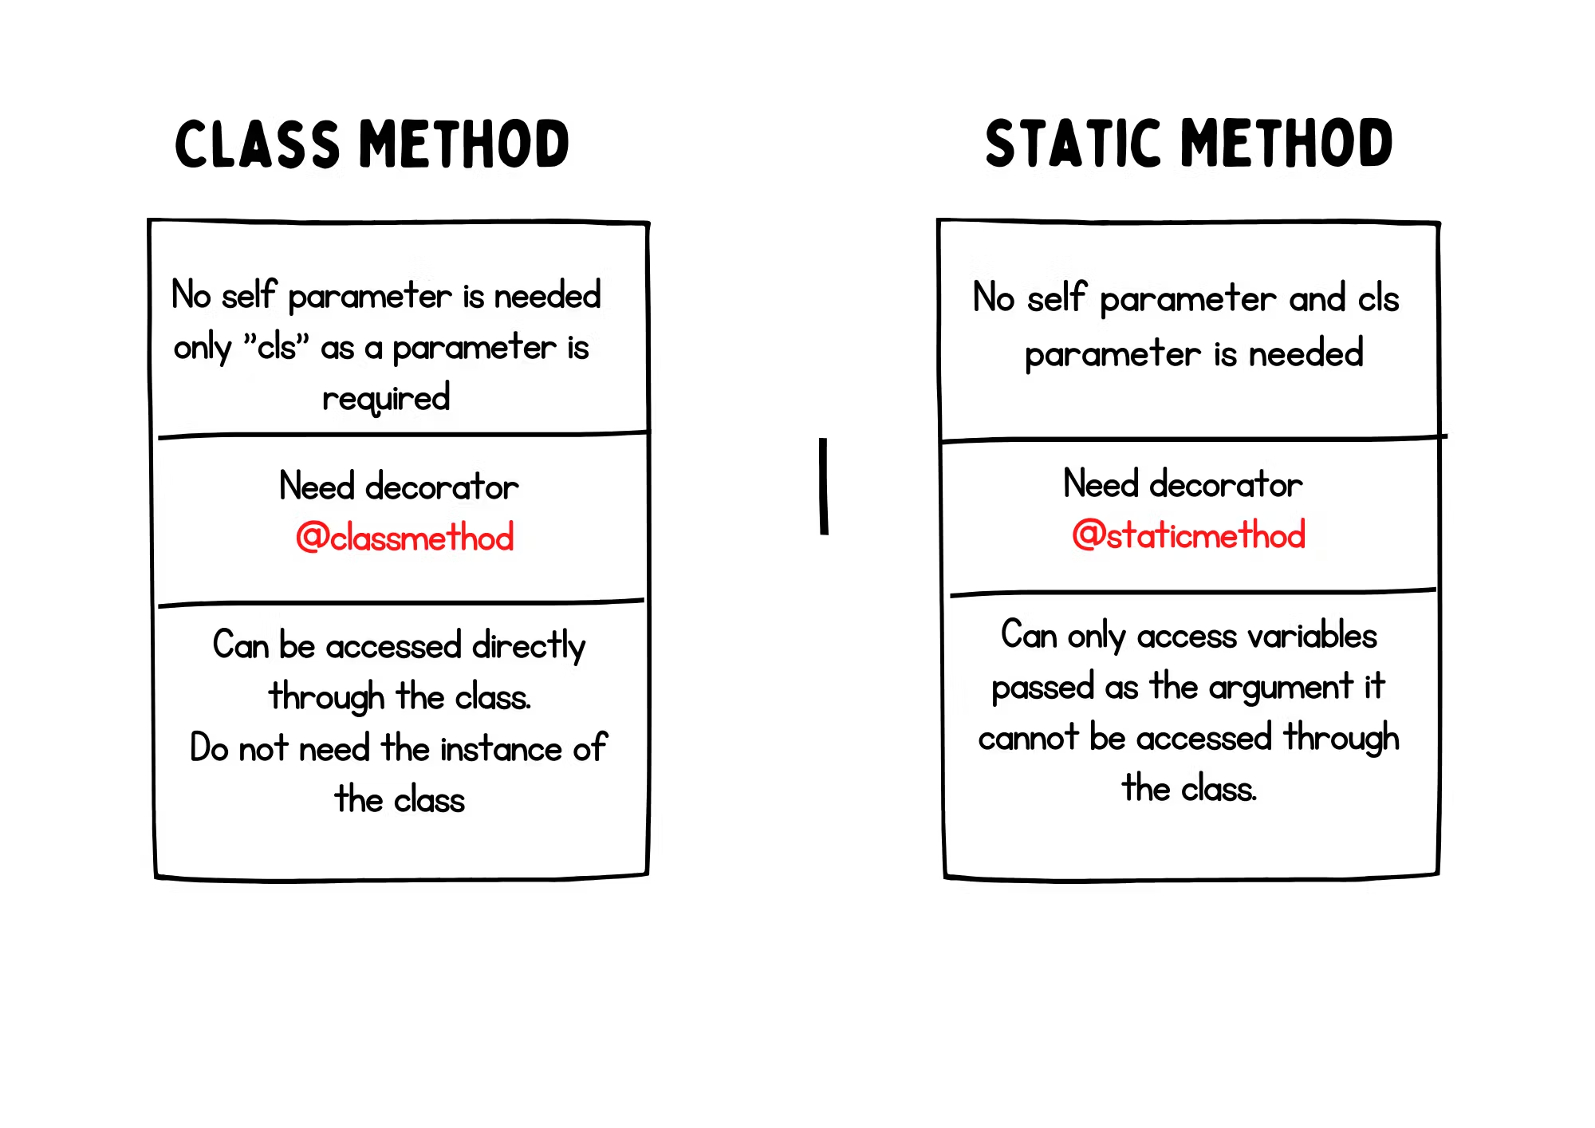
Static Methods
A static method does not depend on instance or class; behaves like a regular function, but it is inside a class.
Uses the @staticmethod decorator.
Example:
class Dog:
@staticmethod
def info():
print(“Dogs are loyal animals.”)
Explanation: Static methods are used for utility functions within the class that don’t need access to class or instance attributes.
Key Points:
No self or cls arguments required.
Useful for grouping logically related functions with the class, even if they don’t modify object or class state.
Notes:
Static methods in Python do not use instance or class attributes, which is one of their defining characteristics.
- Utility function → Helper function

Slide 14
Object-Oriented Programming (OOP) Inheritance

Slide 15
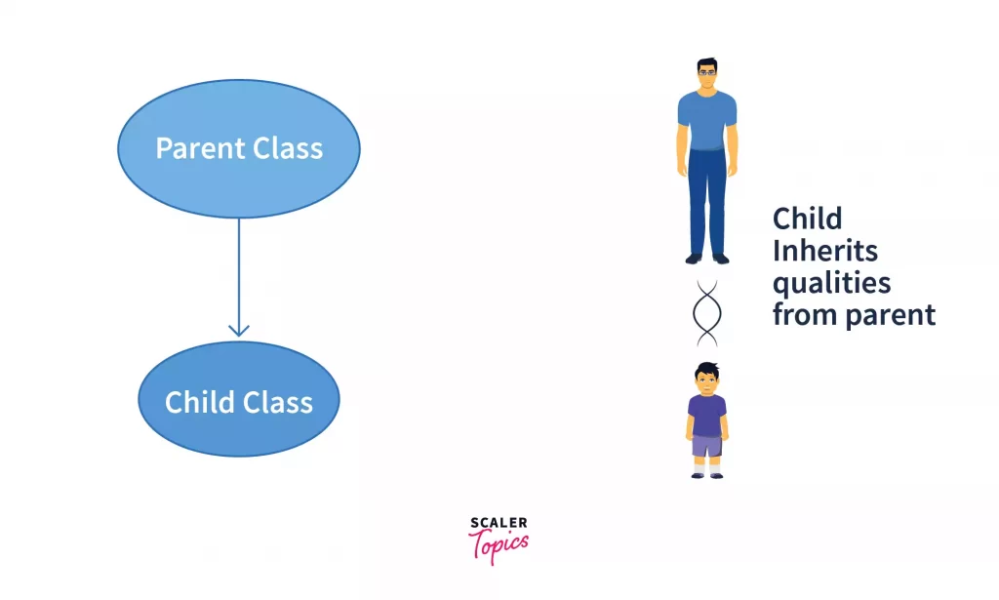
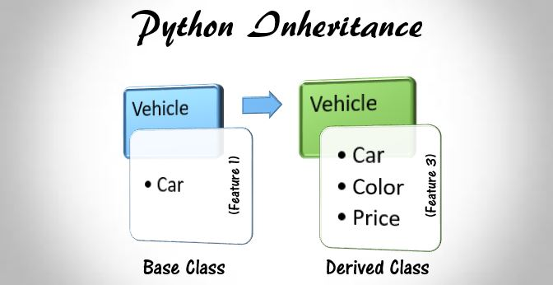
Inheritance
Inheritance is a fundamental concept in OOP that allows one class (the child class) to inherit the properties and behaviors (methods) of another class (the parent class).
Analogy:
Consider inheritance as a family tree, where traits and behaviors are passed down from parents to children.
Purpose:
Code Reusability
Extend properties and functionality of an existing class in new class.
No need to repeat code in sub classes.
It allows for a more organized and maintainable code structure.
Notes:
Analogy: تشبیہ
- The process of creating new classes by extending the properties and functionality of an existing class.

Slide 16
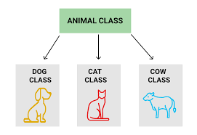
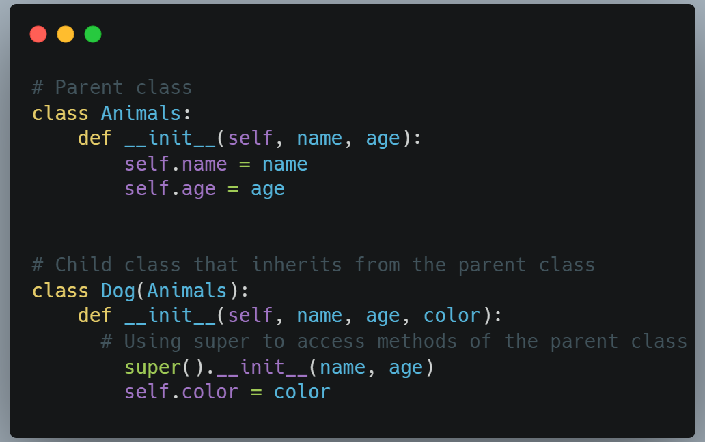
Parent Class (Super Class)
Serves as a base class for other classes to inherit from.
Can define:
Attributes (e.g., species, age)
Methods: (e.g., make_sound())
Example
class Animal: # Parent Class
def __init__(self, species, age):
self.species = species
self.age = age
def make_sound(self):
return “Some sound”
Notes:
It contains attributes and methods that are common to all derived classes.

Slide 17
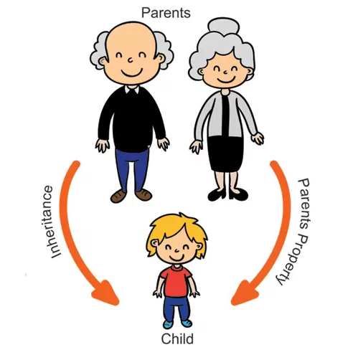
Child Class (Sub class)
Inherits properties and methods from the parent class.
It can also have additional attributes and methods or override existing ones.
Characteristics:
Inheritance: Inherits attributes and methods from the parent class.
Overriding: Can redefine methods to provide specific implementations.
Example:
Class Name: Dog (inherits from Animal)
Additional Attribute: breed
Overridden Method: make_sound() to return “Bark!”
class Dog(Animal):
def __init__(self, species, age, breed):
super().__init__(species, age)
self.breed = breed
def make_sound(self):
return “Bark!”
Notes:
super().__init__() calls the parent class constructor to reuse initialization code.
The child class, also known as the derived class or sub class.

Slide 18
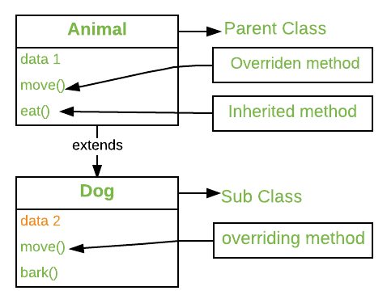
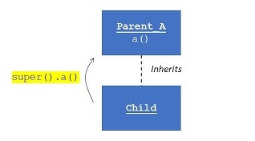
Overriding Methods
A child class can override a method from the parent class by redefining it.
Enables polymorphism: Same method name behaves differently across classes.
Example:
In the Dog class, the make_sound() method is overridden to return “Bark!” instead of the generic “Some sound” from the Animal class.
Using super():
super() lets the child class access methods of the parent class, especially useful in constructors.
Keeps the code clean and maintainable by avoiding hardcoding the parent class name.

Slide 19
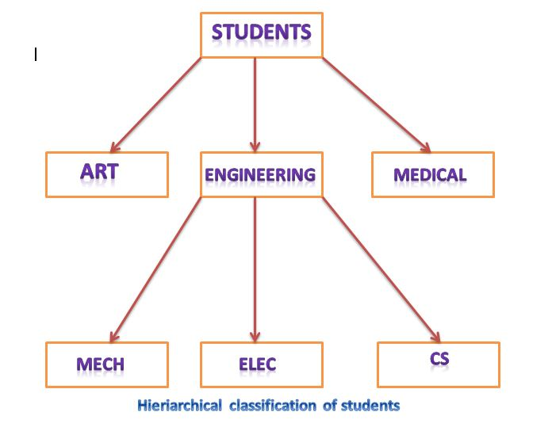
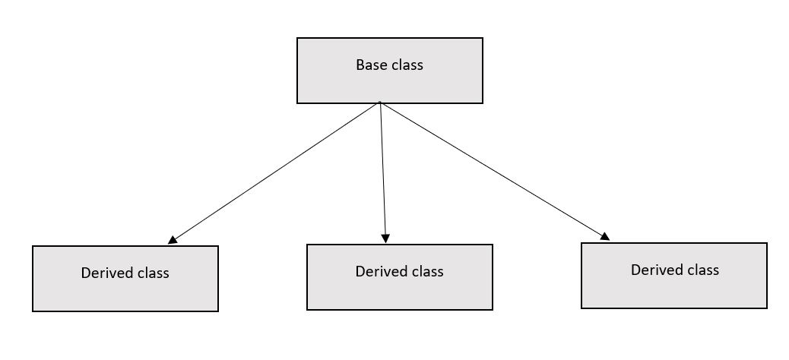
Hierarchical Inheritance
Multiple child classes inherit from the same parent class.
Characteristics:
Allows for shared attributes and methods from a common parent class.
Promotes code reusability.
Different child classes can have additional, unique functionality.
Example:
Parent Class: Animal
Child Classes: Dog, Cat
class Animal:
def make_sound(self):
return “Some sound”
class Dog(Animal):
def bark(self):
return “Woof!”
class Cat(Animal):
def meow(self):
return “Meow!”

Slide 20
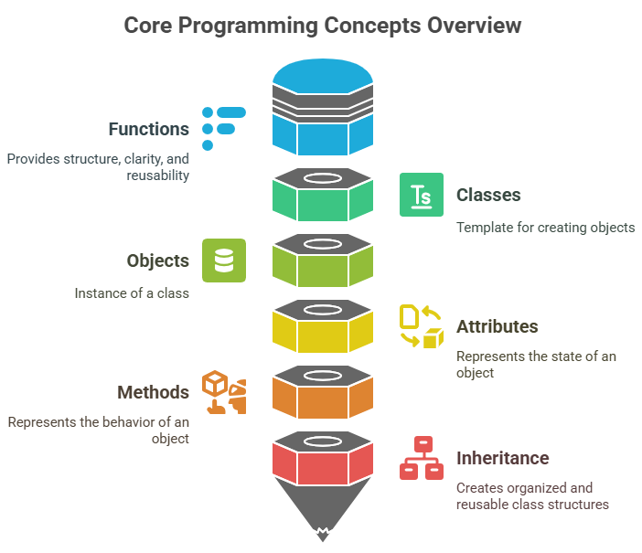
Key Takeaways
Functions provide structure, clarity, and reusability.
Learn to use def, return, arguments, and scope effectively.
Use positional, keyword, and variable-length arguments where appropriate.
Class: Template for objects.
Object: Instance of a class.
Attributes: Represent state.
Methods: Represent behavior.
Types of Methods: Instance, Class, Static.
__init__: Constructor for initialization.
Inheritance helps create an organized, reusable, and extendable class structure.
Use inheritance to model “is-a” relationships (e.g., A Dog is an Animal).
Choose the right type of inheritance based on design needs.
Be cautious with multiple and hybrid inheritance due to increased complexity.

Slide 21

Happy Coding

